Slide 1
Introduction to Graph Neural Networks Part - 1
Animesh
PhD Scholar (IIT Kharagpur)

Slide 2
Why do we need GNNs ?

Slide 3
Shortcomings of Traditional Deep Learning Models ?
Data in Euclidian space
Data in Non-Euclidian space

Slide 4
Shortcomings of Traditional Deep Learning Models ?
Deep neural networks can fail to capture the intricate relationships and dependencies in graph-structured data due to the following reasons:
Arbitrary size and structure
Non-Euclidian data: Traditional DNN are not well suited for this kind of data, they cannot process graph topology directedly.
Permutation Invariance: The representation of a graph should be invariant to the ordering of the nodes, which is not a property that traditional deep learning models inherently possess.

Slide 5
What are the Gaps filled by GNNs?
Explicit Modelling of Graph Structures
Feature learning from Topology, Node Features and Edge features.
Flexibility with various graph properties: GNNs can handle varying size, types(directed, undirected) and complexities(dynamic and heterogenous).
Superior performance in graph related tasks like Node prediction, link prediction, graph generation etc.

Slide 6
Why it Might be a Good Idea to Pursue Research in GNNs ?

Slide 7
In Production Applications of GNNs?
Uber Eats:
Recommendation of food, reported performance boost over 20%.

Slide 8
In Production Applications of GNNs?
DeepMind:
Traffic prediction with advanced Graph Neural Networks

Slide 9
In Production Applications of GNNs?
PinSAGE: Graph Convolutional Neural Networks for Web-Scale Recommender Systems.
Used by Pinterest in production.

Slide 10
In Production Applications of GNNs?
GraphCast: AI model for faster and more accurate global weather forecasting.
DeepMind introduced this in 2023 and is used by weather forecasting agencies like ‘ECMWF’ etc.

Slide 11
In Production Applications of GNNs?
RFdiffusion: A generative model for protein design (2023).
[operates on E(q)-GNN.]
Baker-Lab: De novo design of protein structure and function with Rfdiffusion.

Slide 12
In Production Applications of GNNs?
Molecule Classification and drug Discovery.
Cell: A Deep Learning Approach to Antibiotic Discovery
In production: EnBiotix, an antibiotic drug discovery company.

Slide 13
In Production Applications of GNNs?
LiGNN: Graph Neural Networks at LinkedIn (2024)
In production: LinkedIn

Slide 14
Where does GNNs come from ? Background and Origin !

Slide 15
Traditional Graph Machine Learning Approaches:
These methods aim to represent nodes or entire graphs as low-dimensional vector embeddings, preserving the structural properties of the original graph.
DeepWalk (2013)
Node2Vec (2016)
Struc2vec (2017)

Slide 16
Traditional Graph Machine Learning Approaches:
These approaches presents mainly two challenges:
First, no parameters are shared between nodes in the encoder, which leads to computationally inefficiency, since it means the number of parameters grows linearly with the number of nodes.
Second, the direct embedding methods lack the ability of generalization, which means they cannot deal with dynamic graphs or generalize to new graphs.
To Overcome these challenges comes the GNNs which are based on CNNs and Graph Embeddings.

Slide 17
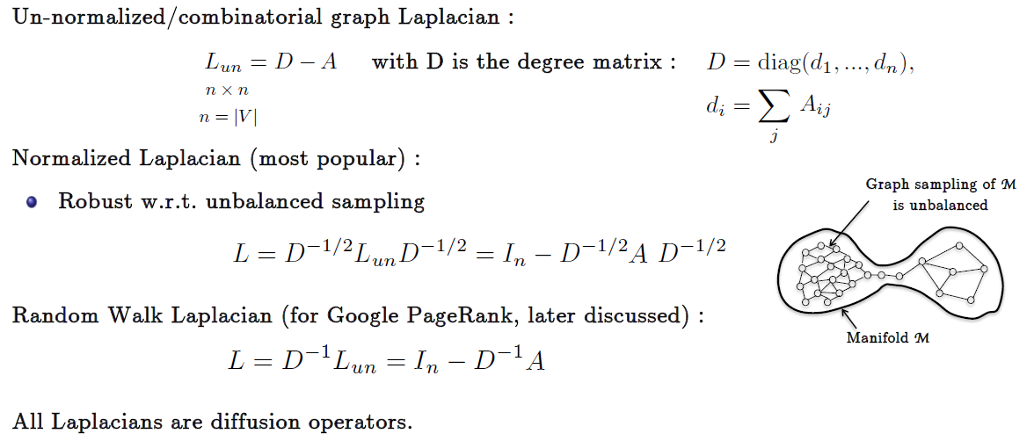
Origin of Graph Neural Networks:
Spectral Graph Theory:
The notion of doing convolution on graphs was initially inspired by spectral graph theory, which studies the properties of graphs through their eigenvalues and eigenvectors.
The Fourier transform for graphs is defined using the graph Laplacian matrix, and convolutions can be defined as multiplications in the Fourier domain.
Most fundamental tool in SGT is the graph Laplacian operator L, it is the central operator of diffusion process in graphs.

Slide 18
Origin of Graph Neural Networks:
Idea of Convolution in Graphs:

Slide 19
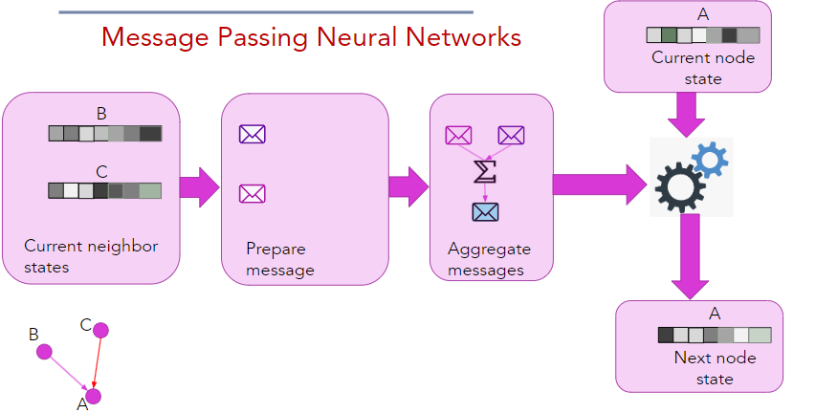
Origin of Graph Neural Networks:
Idea of Message Passing on Graphs:

Slide 20
Origin of Graph Neural Networks:
Idea of Message Passing on Graphs:
The core of GNNs lies in the message passing mechanism, which allows nodes to iteratively update their representations by exchanging messages with their neighbors. The message passing process can be formulated as:

Slide 21
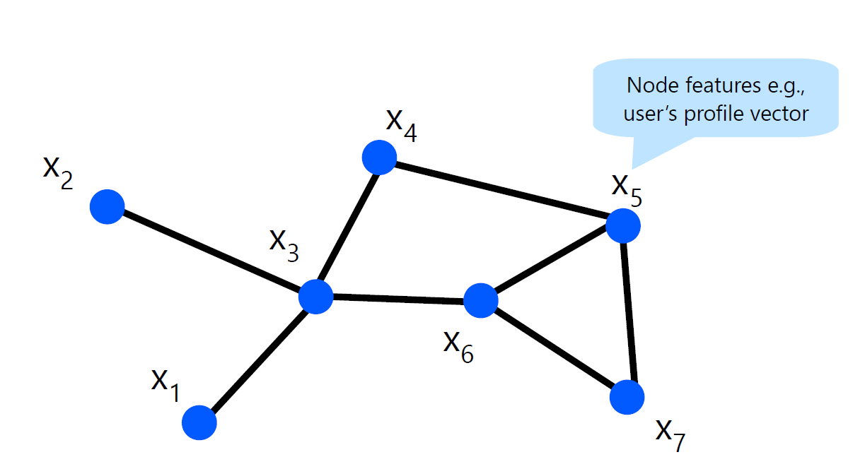
Example of GNNs: Initializing Node Embeddings
Example of Message Passing on Graphs:

Slide 22
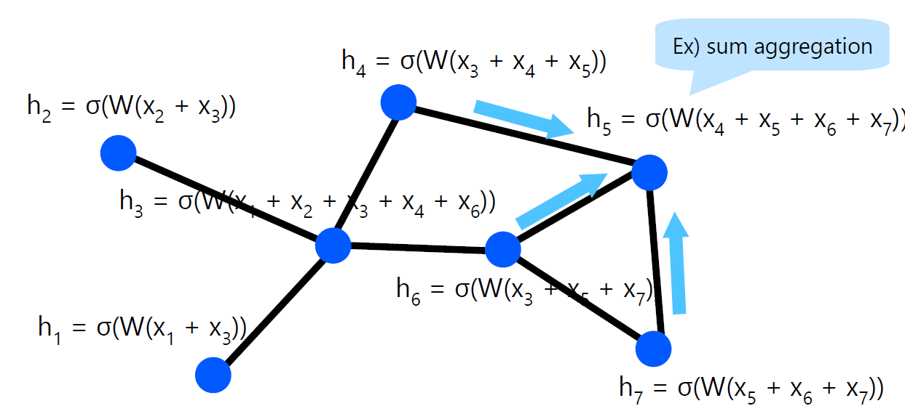
Example of GNNs: Aggregate features
Example of Message Passing on Graphs:

Slide 23
Where to use GNNs ?

Slide 24
What GNNs can do ?

Slide 25
What are some of the Most used GNN Architectures ?

Slide 26
Graph Neural Network Architectures:
GCN [ICLR,2017] :
GCNs were one of the earliest and most widely adopted GNN architectures, introduced by Kipf and Welling in 2017. The key idea behind GCNs is to perform a first-order approximation of spectral graph convolutions using a localized filter.
The GCN Layer is defined as:
The key Strength of GCN is the simplicity but they have a few shortcoming as well:
Over Smoothening
Isotropic Filters

Slide 27
Graph Neural Network Architectures:
GCN [ICLR,2017] :
GCNs were one of the earliest and most widely adopted GNN architectures, introduced by Kipf and Welling in 2017. The key idea behind GCNs is to perform a first-order approximation of spectral graph convolutions using a localized filter.
The GCN Layer is defined as:
The key Strength of GCN is the simplicity but they have a few shortcoming as well:
Over Smoothening
Isotropic Filters

Slide 28
Graph Neural Network Architectures:
Over Smoothening Problem:
All node embeddings may converge to the same value after stacking multiple layers of GNNs.

Slide 29
Graph Neural Network Architectures:
Over Smoothening Problem:
All node embeddings may converge to the same value after stacking multiple layers of GNNs.
Andreas Roth [2023]: Rank Collapse Causes Over-Smoothing and Over-Correlation in Graph Neural Networks.
I did a little experiment to see what happens to the rank of learned feature matrix as we increase the number of layers:
Applying GCN of Karate Club dataset: (Node Classification: 2 classes)
GCN Layer 1: Rank 16
GCN Layer 2: Rank 14
GCN Layer 3: Rank 13
GCN Layer 4: Rank 13
GCN Layer 5: Rank 4

Slide 30
Graph Neural Network Architectures:
Over Smoothening Problem:
All node embeddings may converge to the same value after stacking multiple layers of GNNs.
Andreas Roth [2023]: Rank Collapse Causes Over-Smoothing and Over-Correlation in Graph Neural Networks.
I did a little experiment to see what happens to the rank of learned feature matrix as we increase the number of layers:
Applying GCN of Karate Club dataset: (Node Classification: 2 classes)
GCN Layer 1: Rank 16
GCN Layer 2: Rank 14
GCN Layer 3: Rank 13
GCN Layer 4: Rank 13
GCN Layer 5: Rank 4

Slide 31
Graph Neural Network Architectures:
Over Smoothening Problem’s Solution:
GCN-2 [ICML-2020]: Simple and Deep Graph Convolutional Networks
Introduced the Idea of
Residual Connection
Identity Mapping
Both the ideas are borrowed from ResNet.

Slide 32
Graph Neural Network Architectures:
GAT [ICLR, 2018] :
To address the limitations of GCNs, Veličković et al. (2018) introduced Graph Attention Networks (GATs), which employ an attention mechanism in the message passing process. The key idea is to allow nodes to attend to different neighbors with varying importances, enabling the model to capture the most relevant structural information
The GAT Layer is defined as:

Slide 33
Graph Neural Network Architectures:
GAT [ICLR, 2018] :
GAT address some of the limitations of GCN like:
Anisotropic filters: The attention coefficients introduce anisotropy, allowing the model to capture different types of relationships between nodes.
GAT-V2 [ICLR, 2022] :
Brody et al. show that GAT does not actually compute the expressive, well known, type of attention (Bahdanau et al.,2014), which we call dynamic attention.

Slide 34
Graph Neural Network Architectures:
L-CAT [ICLR, 2023] :
J. Andrian et al. introduced (L-CAT): a GNN architecture that automatically interpolates between GCN, GAT and CAT in each layer, by adding two scalar parameters.
L-CAT enables a number of non-trivial benefits.
It can switch between existing layers.
Learns the amount of attention necessary for each case.
As the performance of the models are data dependent so by combining these it removes the necessity of cross-validating the type of layers.

Slide 35
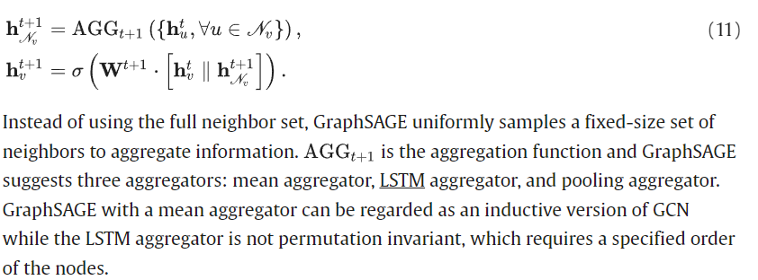
Graph Neural Network Architectures:
GraphSAGE [NeurIPS, 2017] :
GraphSAGE, introduced by Hamilton et al. (2017), is an inductive GNN architecture designed to enable learning on unseen nodes or graphs. Unlike GCNs and GATs, which are transudative (i.e., they require the entire graph structure during training), GraphSAGE can generalize to new data by sampling and aggregating information from a fixed-size neighborhood.

Slide 36
How to use GNNs ?

Slide 37
General Design Pipeline of GNNs:
Find Graph Structure:
At first, we have to find out the graph structure in the application. There are usually two scenarios:
Structural Scenarios: The graph structure is explicit in the applications, such as applications on molecules, physical systems, knowledge graphs and so on.
Non-Structural Scenarios: Graphs are implicit so that we have to first build the graph from the task, such as building a fully-connected “word” graph for text or building a scene graph for an image.
After we get the graph, later part is to design GNN on that specific graph.

Slide 38
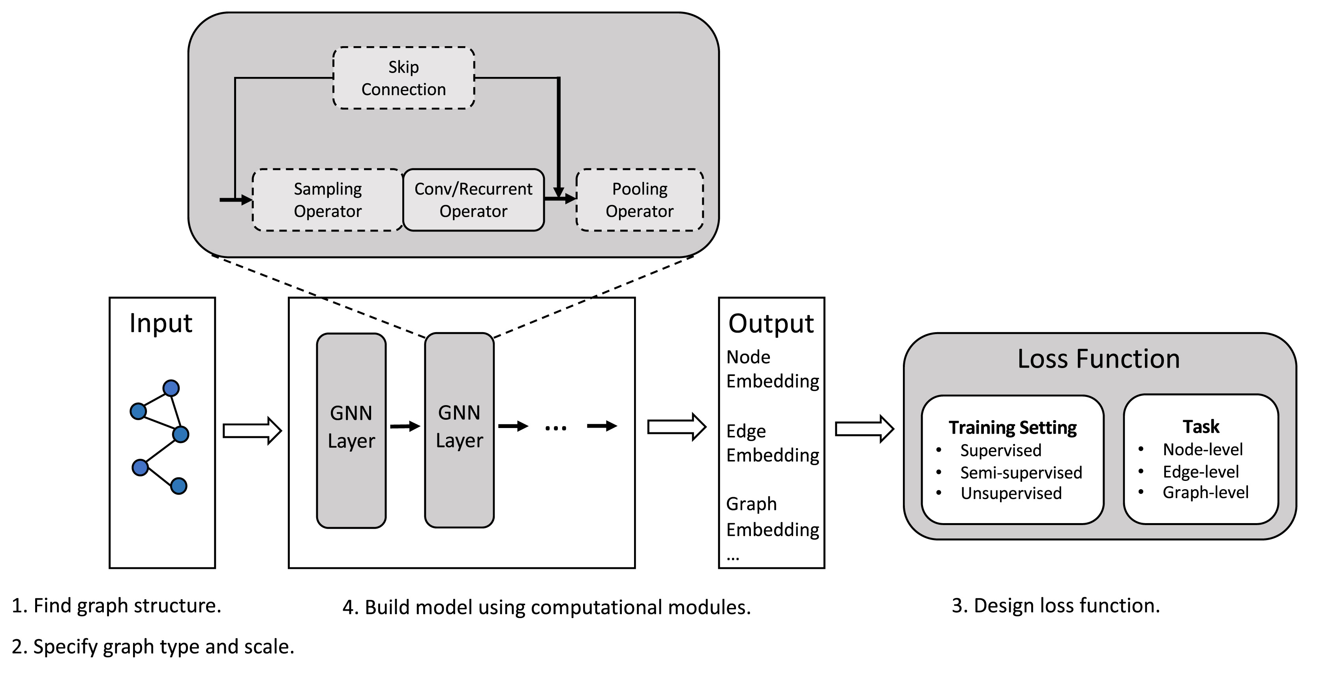
General Design Pipeline of GNNs:
End-to-End Design Pipeline of GNN Models.

Slide 39
Tools and Datasets for GNNs:
Open Graph Benchmark

Slide 40
A few resources for GNNs:
Graph neural networks: A review of methods and applications
A Comprehensive Survey on Graph Neural Networks
Book: Graph Neural Networks
Book: Graph Representation Learning
Course [Plaban Kumar Bhowmick]: Graph Machine Learning Foundations and Applications (AI60007)
Stanford Course :CS224W: Machine Learning with Graphs

Slide 41
GNNs Part -2 :
E(Q) Graph Neural Networks.
……Upcoming!

